Slide 1
.NET Core (3) in a nutshell

Slide 2
.NET Core (3)
Cross-platform, free and open-source managed framework
Different from .NET framework, not just a new version of it
Designed for microservices (faster and slimmer than .NET Framework)
Support UWP and ASP.NET Core. Universal Windows Platform
Used to build Console apps / webapi / webapps / libraries
Notes:
New common language runtime CLR → CoreCLR
New framework class library FCL → CoreFX
even .Net framework could be running in a container. But it needs to be run on windows or through mono (for linux)
Universal Windows Platform UWP to build apps for Windows 10

Slide 3
.NET Core, .NET Framework and .NET Standard
.NET Standard
.NET Core
.NET Framework
Mono
…
Notes:
.NET standard is a formal specification of .NET APIs
Defines uniform set of BCL APIs for all .NET implementations to implement, independent of workload
Enables developers to produce portable libraries
Reduces or even eliminates conditional compilation of shared source due to .NET APIs, only for OS APIs.

Slide 4
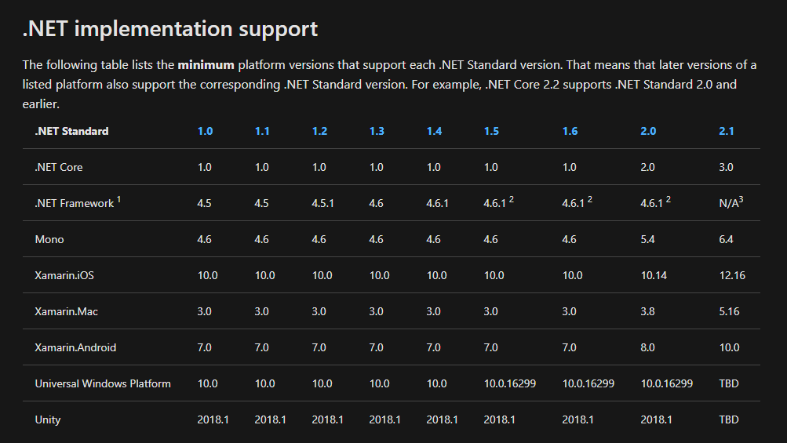
.NET Core, .NET Framework and .NET Standard

Slide 5
.NET Core 3, a real project example
Payroll webapp will be used by HR team to run the integration between Oracle HR and, initially only, the uk payroll system (Omnipay)
http://gitlab.abcam.com/abcamrepo/payroll

Slide 6
.NET Core 3, a real project example
Kestrel
Program.cs and Startup.cs (WebServer and Middleware pattern)
Configuration (env. Variables)
DI
Logging
From dev pc to web farm
Teamcity and octopus configs
How we run .net core in current stack
Notes:
Kestrel – crossplatform webserver for ASP.NET Core
ConfigureWebHostDefaults UseKestrel
ConfigureKestrel

Slide 7


Kestrel
Cross-platform webserver for ASP.NET Core
Can be used alone or behind a reverse-proxy
Notes:
Supports:
HTTPS
Opaque upgrade used to enable WebSockets
Unix sockets for high performance behind Nginx
HTTP/2 (except on macOS†)

